Slide 1



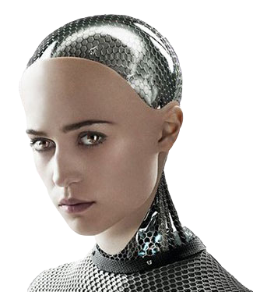
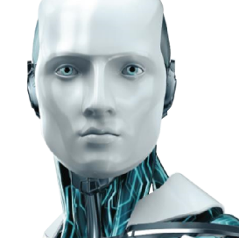
A.V.A
The Development of a Chatbot
By Ayodamola Ajibola, Khawla El Masalti, Jia Ren Goh, Alex Moreton
Nottingham Trent University
School of Computer Science
Module: ISYS20182: Practical Proj Mgt & Prof Dev
Tutor: Andreas Oikonomou
Notes:
To use this title animation slide with a new image simply 1) move the top semi-transparent shape to the side, 2) delete placeholder image, 3) click on the picture icon to add a new picture, 4) Move semi-transparent shape back to original position, 5) Update text on slide.

Slide 2


Introduction
01.
05.
Brief Introduction
Results
02.
06.
Project Aims and Objectives
Limitations and Future Work
03.
07.
Existing Alternatives
Conclusion
04.
08.
Development Approach
Live Demo
1
Notes:
Within this presentation we’ll be identifying the projects Aim and Objectives which will consist of the development and features
the project needs to achieve based on research with the use of our project management methodology.
Furthermore a research of existing alternatives and how their development helped inspire our finished software.
We’ll also show some examples of the differences between starting software's and our final software.
We’ll talk about the development approach used, the programming language,
and why we chose to implement the chatbot the way we did
A display for final results and the finished software.
An evaluation of the limitations and possible future work that could be done and a conclusion.

Slide 3
Projects Aim and Objectives
Pivotal Tracker | Trello
Story-based project management tool | Board-style project management tool
Suited for high-level agile workflow | Suited for low-level projects over a long span of time
Free for up to 3 users for 30-days | Free (Pay for additional storage space)
Figure 1: Pivotal Tracker vs Trello
2
Notes:
In discussion over how to organize our project, we discussed using trello or pivotal tracker, and chose trello due to it’s free use.

Slide 4
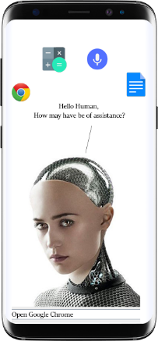
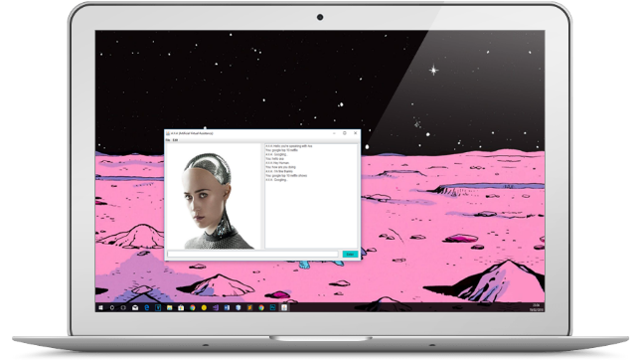
Aims
Artificial Virtual Agent- Software
01.
Continues conversation.
02.
Keyword detection.
03.
Profile templates.
04.
Dealing with standard queries
05.
Crossing platforms app.
Figure 2: Ava on phone
Figure 3: Ava on laptop
3
Notes:
We aim to develop a software that as the ability to be used on multiple platforms and use keywords plus phrases to identify how to respond to the user.
The software should be able to deal with standard queries and have features that makes the users experience interactive.

Slide 5
Objectives
A.V.A Should :
01.
Be kept updated and maintained.
03.
Restrictions placed on users to prevent unacceptable behaviour.
02.
Be able to make use of text to speech systems.
04.
Multiple access levels in place to prevent unauthorised access to data.
Note other objectives were
added to the pivotal tracker.
4
Notes:
Four main objectives: To keep our system in working order, make use of a text to speech system, limit offensive and unacceptable behaviour and prevent unauthorised data access.

Slide 6
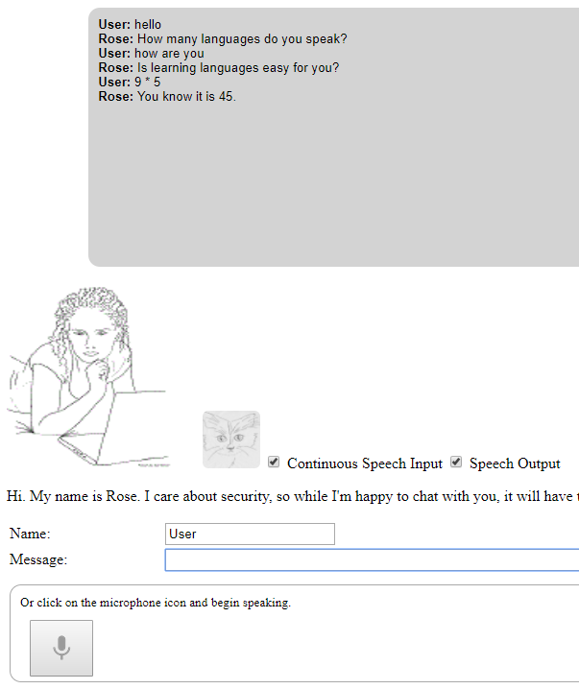
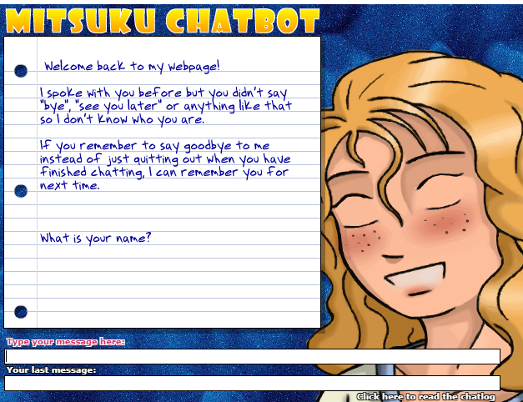
Other existing
Chat bots
As mentioned by (AISB, 2017) organization Mitsuku chatbot is the winner of the Loebner Prize 2017.
Figure 4: Rose
Figure 5: Mitsuku
5
Notes:
While conducting our research we found two pre existing chatbots that had been given notoriety by the AISB organisation and Mitsuku who was the winner of the Loebner Prize in 2017

Slide 7
Other Existing Chatbots: 1. Rose
Rose
Text recognition
Speech recognition
Avatar
Inputs and outputs
with text or voice
Figure 6: Rose being used
6
Notes:
Rose is a winner of the loebner prize, and has features including text and speech recognition, an avatar for the user to interact with and can output with text or voice

Slide 8
Other Existing Chatbots: 2. Mitsuku
Mitsuku
Text recognition
Avatar
Learns from users
Speaks three
languages
Figure 7: Mitsuku being used
7
Notes:
While conducting research into Mitsuku we discover its feature consisted of the available to learn from the users speak three languages and use text recognition.
It also has an avatar.

Slide 9
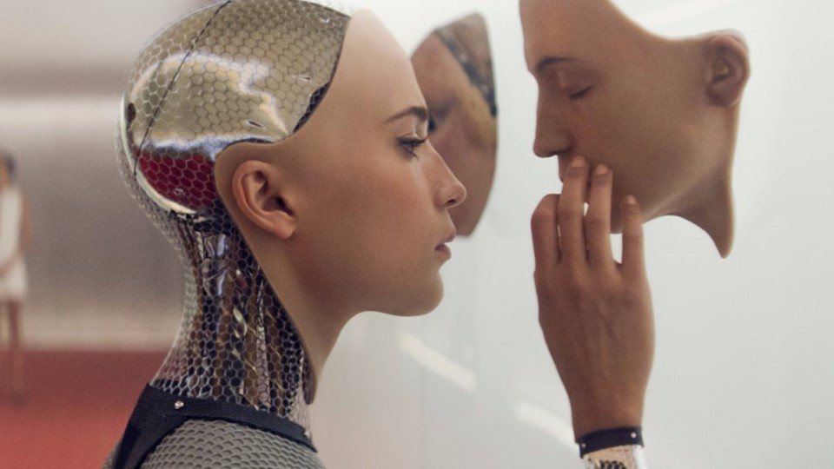
A.V.A Features
1
Text recognition
Choice of avatar and voice
Can perform searches,
Cross-platform compatibility
Implements learner class
Website with downloadable
version
Figure 8: AVA female image
8
Notes:
Ava improves on these two, with a text recognition system, a variable voice and avatar to allow for user customisation, a better search system, easy cross platform compatability, a learner class and working website.

Slide 10
A.V.A Features
2
Opens Operating System programs
Choice of avatar and voice
User manual
Tell Date/time
Complete calculations
Contact us
Note other features will be displayed during demonstration.
Figure 9: AVA male image
9
Notes:
In comparison to the pre existing chatbot Ava has the ability to open operating system programs like, web browsers, calculators and documents.
Ava also has a the ability for users to change the voice and avatar of the software by switching between the male and female profiles.
Furthermore AVA can inform the user of real world information like telling them the date and time.
Plus ava can complete complex calculations
The website has a downloadable version plus the ability for users to contact the team

Slide 11
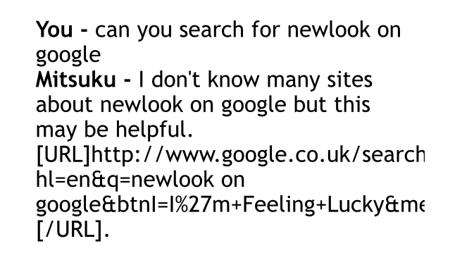
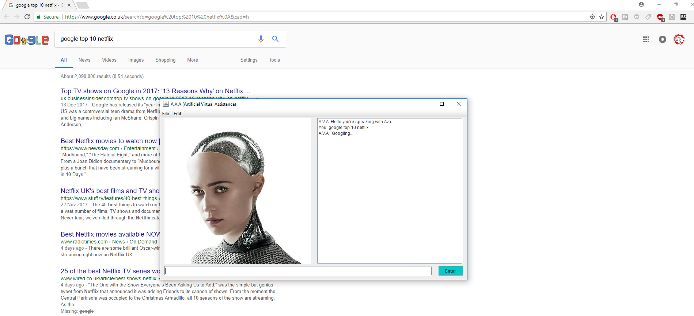
Comparison 1: Searching Mitsuku vs A.V.A
Mitsuku google searching
Ava google searching
Figure 10: Mitsuku google search
Figure 11: AVA google search
10
Notes:
Mitsuku only allows google search through providing a link to the search

Slide 12
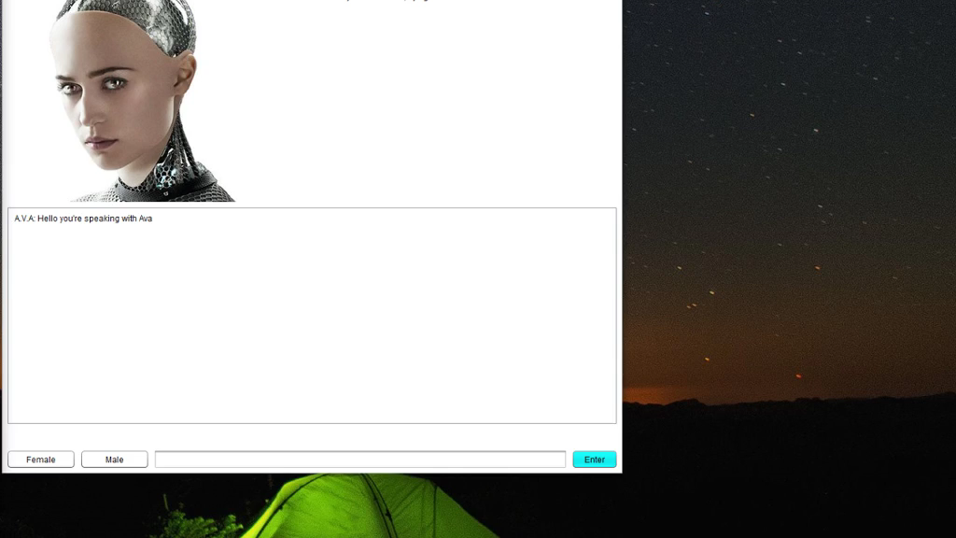
Quick Example: A.V.A Searching
Figure 12: AVA google search extended display
11
Notes:
As you can see, this is a closer view into AVA conducting a google search, which takes the user directly to google unlike its competitors

Slide 13
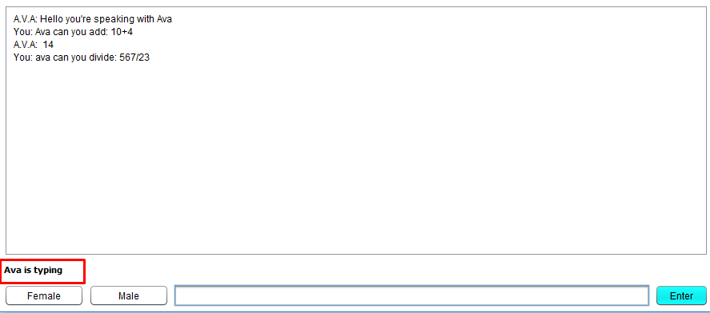
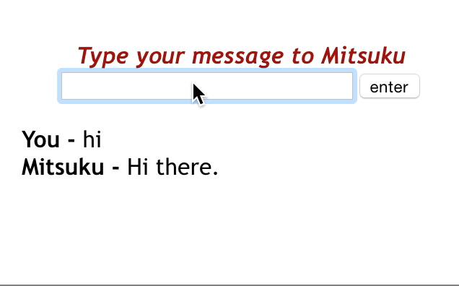
Comparison 2: Typing message / Getting response
Figure 13: Mitsuku typing/response feature
Figure 14: A.V.A typing/response feature
12
Notes:
Mitsuku provides a response immediately, which makes it obvious it is not humanlike and can damage imersion

Slide 14
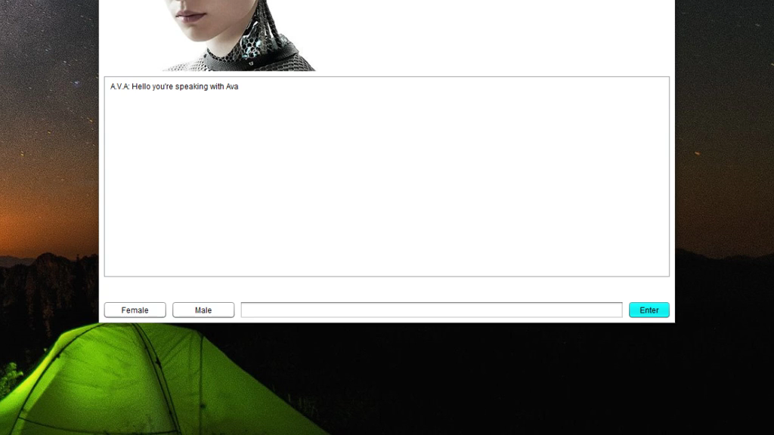
Quick Example: Typing message / Getting response
Figure 15: A.V.A typing/response feature extended display
13
Notes:
As you can see here is an example the implemented chatting and response.
This figure shows AVA informing the user its typing before responding. which previous chatbots don’t have.
This feature was implemented while taking the turning test in mind.

Slide 15
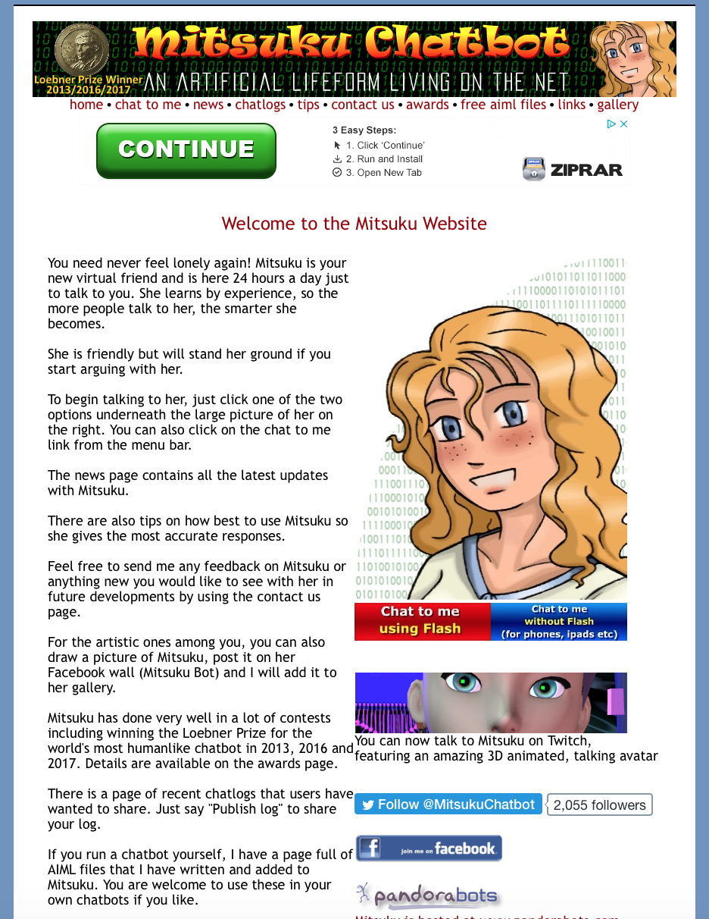
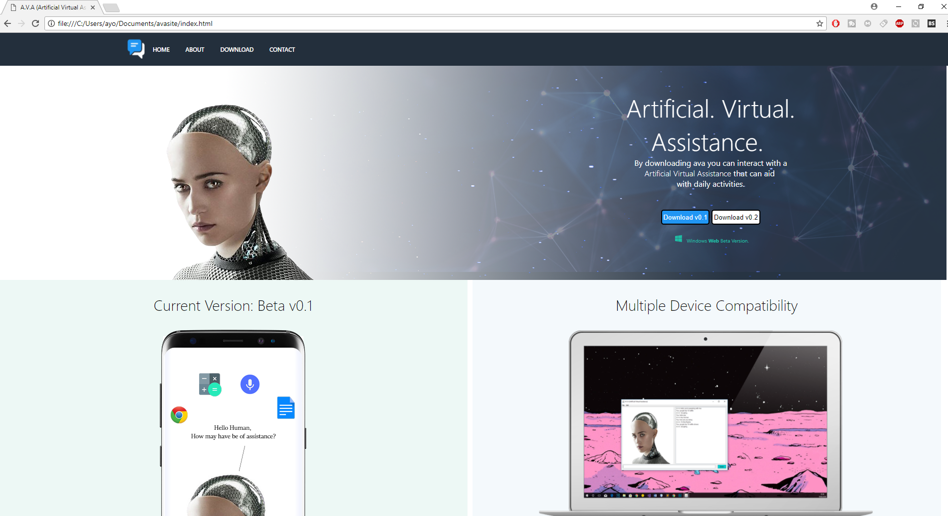
Comparison 3: Website
Mitsuku’s website
Ava’s website
Figure 16: Mitsuku website
Figure 17: A.V.A website
14
Notes:
Mitsuku’s website is quite old and out of date looking, whereas ava’s is much more modern looking and user-friendly

Slide 16
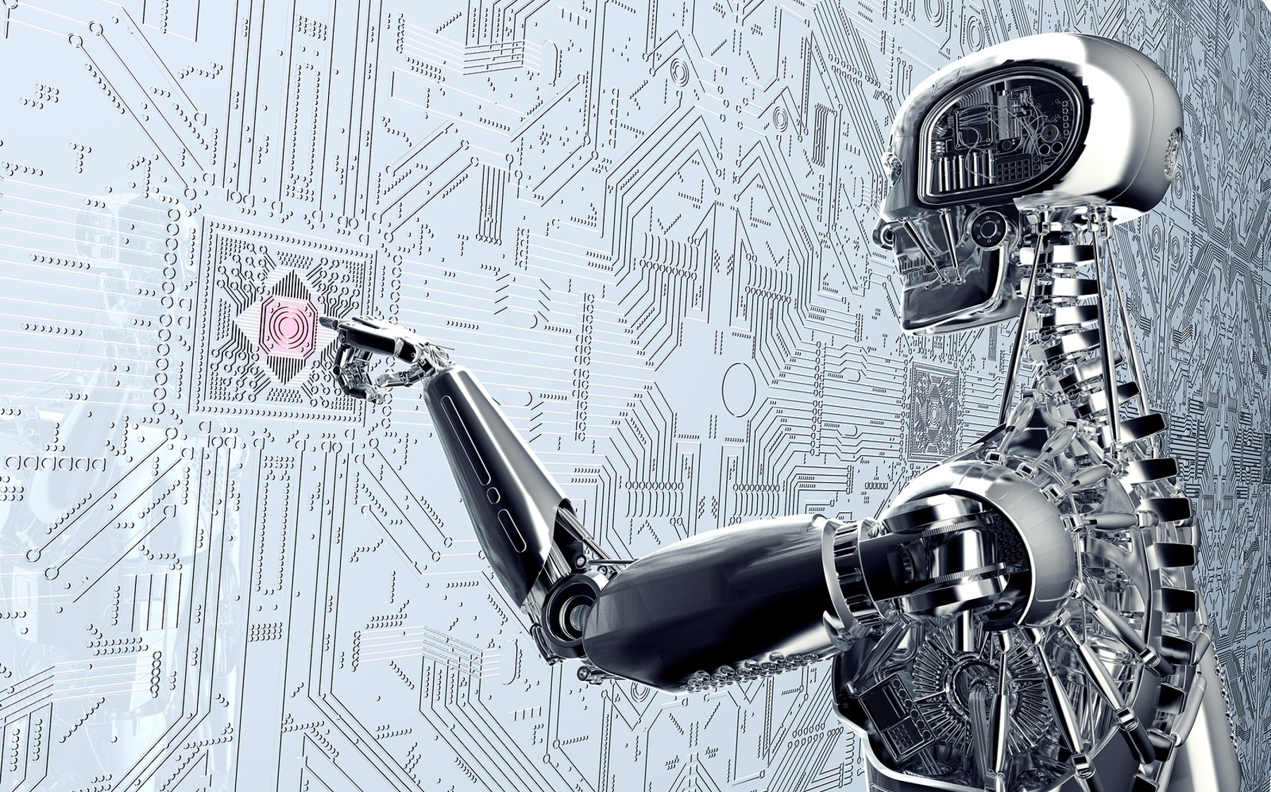
Development
Approach
Followed an Agile project management system
Used the Belbin test to find each member’s strengths and place in the team
Held regular meetings to ensure that members were on track and to exchange ideas on project development
Figure 18: Mitsuku Male Image
15
Notes:
The development process followed an Agile project development methodology with the use of pivotal tracker and github.
We also I identified each users strengths and weaknesses early on to set tasks based on what each individual can do
Regular meetings both online and in person were held to plan tasks and ensure they had been met
Also to exchange ideas

Slide 17
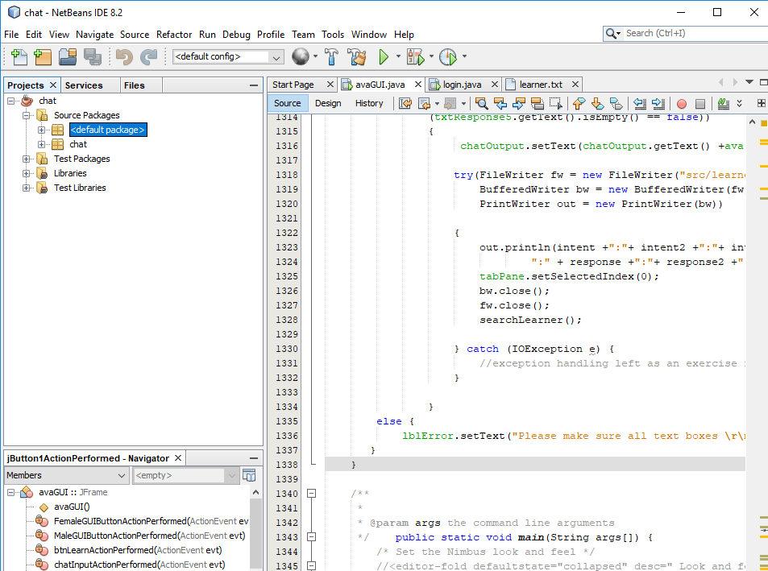

Development Approach
Developed in Java on Netbeans
Java, because implementing the GUI was better than alternatives
Java has a cross platform compatibility
A lot of resources and help available
Figure 19: JAVA and Netbeans
16
Notes:
We originally planned on using C++, but switched to java as the gui was better than the alternatives and cross platform compatibility was better.

Slide 18
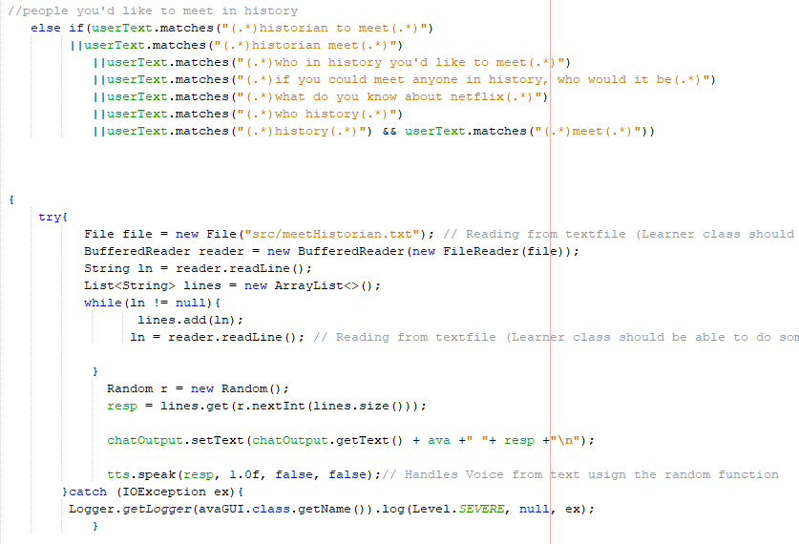
Development Approach
Learner (Algorithm)
Chose not to use an API so we can expand our knowledge in this field
Most APIs do all the features and next to no coding is involved.
User can add their intent with possible chatbot responses.
Figure 20: JAVA and Netbeans 2
17
Notes:
The learner algorithm was implemented so users can store possible intents and phrases with possible responses that ava could give.
The intents and responses were stored in AVAs database. An instruction manual was also provided for users to teach A.V.A
Phrases were matched by catching the key words, and using loops and if statements to search through AVA database
and respond with something relatable to the users input. If AVA doesn’t have any possible response for the users input
It will tell you user it doesn’t know and the user can use the learner to teach the chatbot.
No API was used because they already do all the work and next to no programming is needed, we believed it would be better to push ourselves and learn how to actually
develop a chatbot from scratch so we can acquire knowledge that will be viable in the future

Slide 19
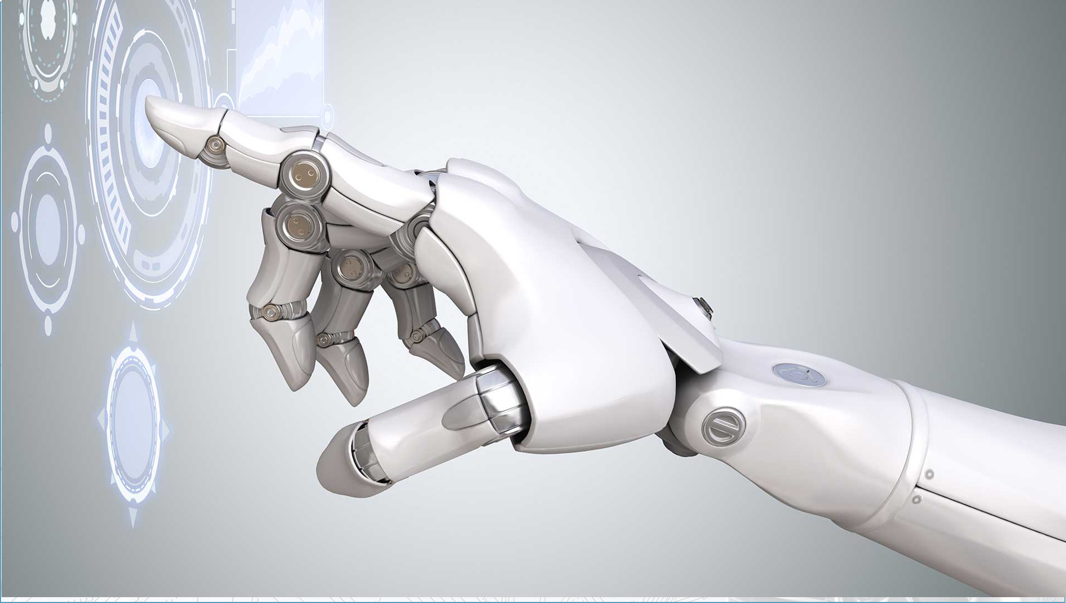
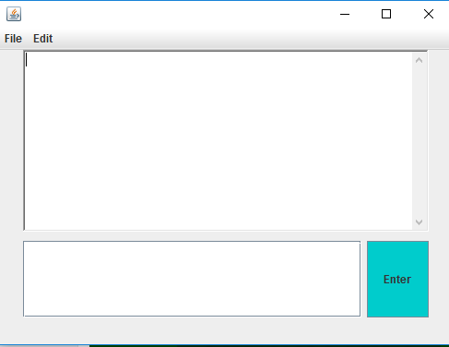
First
Prototype
01.
Pre-programmed
responses to specific
messages
02.
Basic GUI
03.
No machine learning
04.
Lack of text to speech
functionality
Figure 21: First Prototype
18
Notes:
Our original prototype was very basic, with pre-chosen responses only to specific messages, a very basic gui, no text to speech and a complete lack of capability to learn.

Slide 20
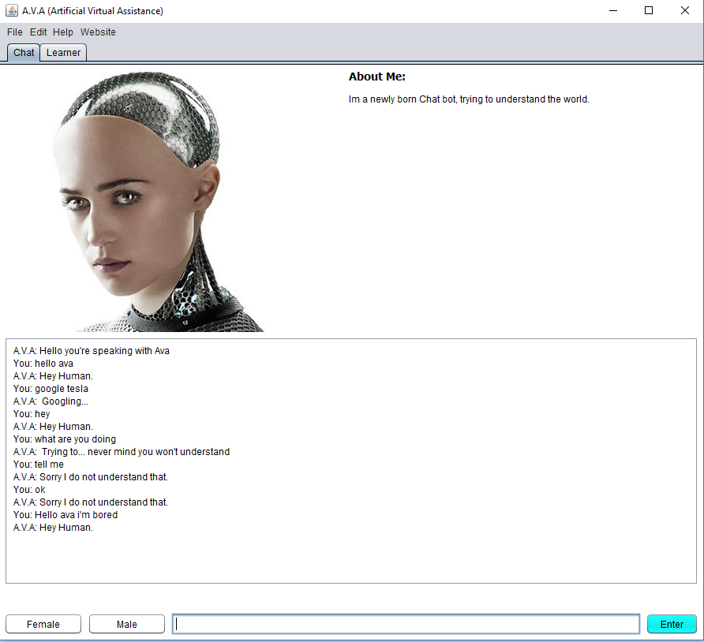
Final
Software
01.
Full GUI with variable voice
and avatar
02.
Responses based on keyword
detection
03.
Capable of calculations, telling
Time and accessing internet
04.
Implemented learner class
Figure 22: final software
19
Notes:
The final GUI design of AVA it can reponse based on keywords and phrases, capable of doing calculations telling the time and accessing the internet.
Plus it has a learner class/

Slide 21
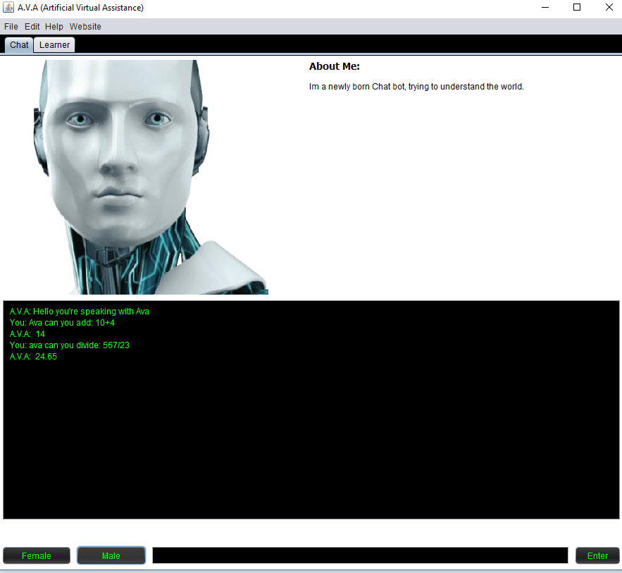
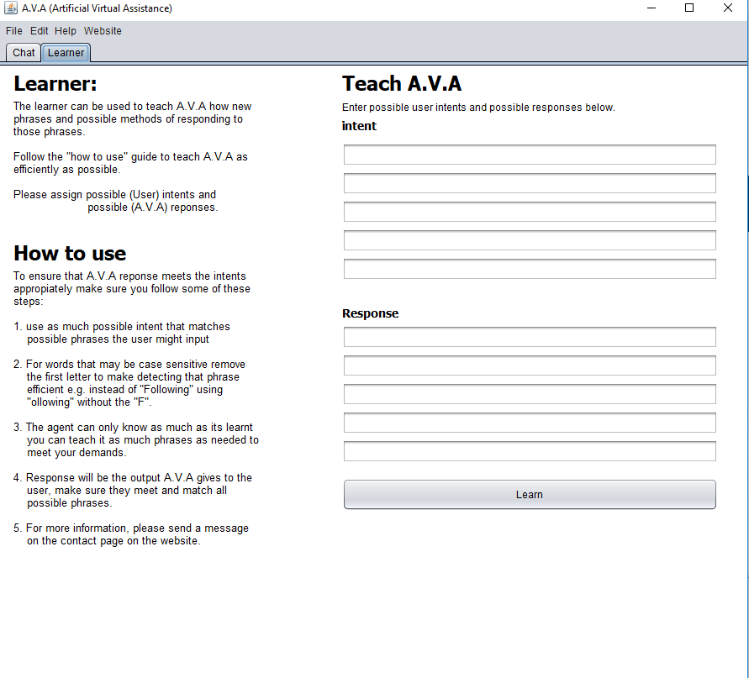
Results: Learner
Figure 23: final software male version
Figure 24: final software learner
20
Notes:
Our learner class was designed to allow several options for intent input and several possible responses back. We also included instructions to help a new user.

Slide 22
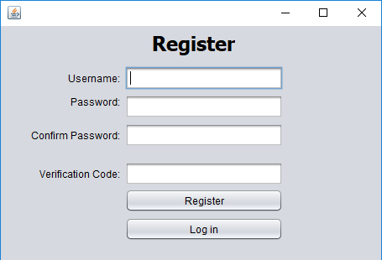
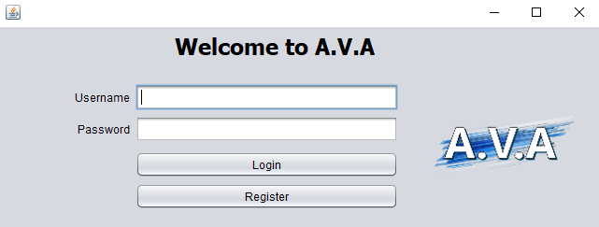
Results: Login / Registration
Figure 25: Final software login
Figure 26: Final software register
21
Notes:
These figures display the final software design for the login and registration

Slide 23
Limitation
Software
Not enough knowledge of machine learning
Not enough knowledge of Artificial Intelligence
Data mining
4 months isn’t enough some developers
have dedicated years into this
Much more testing needed to be done
22
Notes:
We felt we could have done further work, but given our time and knowledge our results were somewhat limited. In particular, additional testing would have helped tremendously.

Slide 24
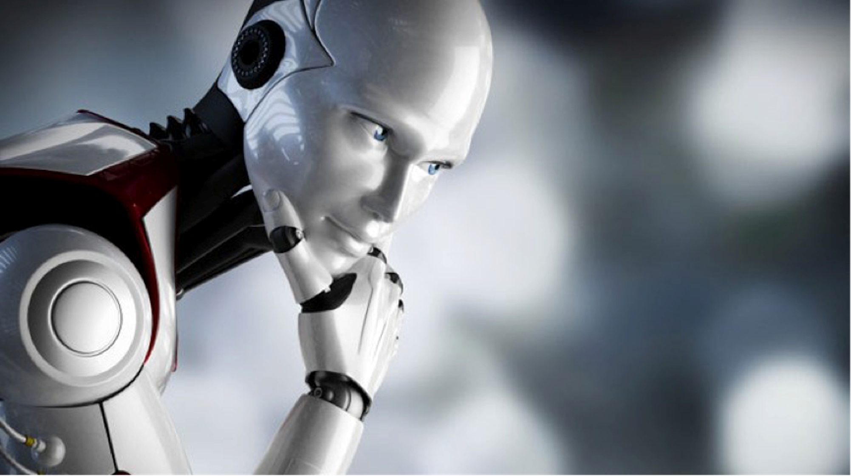
Future
Work
Further integration into other
More users profiles, maybe users can customise the design
Binary search algorithm? Consider Tree searches for searching and finding the most viable responses
programs, allowing for accessing different applications
Profile creation, allowing for users to be ‘remembered’
Learner class more closely integrated with main functions
23
Notes:
Consider learning about more about AI, look into the use of search tree like a
binary search tree algorithm to determine the possible response based on the users input

Slide 25
Conclusion
Why a chatbot and AI agents are needed?
Ease of handling multiple customers
Constant availability
Acting as a personal assistant
Dealing with standard queries
24
Notes:
A chatbot is ideal for handling multiple customers at once and is available 24/7. It is particularly good at handling standard queries. In addition, it can use its various functions to act as a personal assistant.

Slide 26

Thank you for your time
Any questions?
25

Slide 27
References Page 1
First set of background images, slides 1-8, www.wallpapervortex.com. 2018. wallpapervortex white space background. [ONLINE] Available at: https://www.wallpapervortex.com/wallpaper-20503_3d_space_scene_white_white_3d__space_scene.html#.Wu9AF4gvyUk. [Accessed 1 April 2018].
Slides 1-25 NTU logo, www.trentstudents.org. 2018. NTU Active Membership. [ONLINE] Available at: https://www.trentstudents.org/resources/ntu-active-membership-t-cs. [Accessed 7 April 2018]
Front page Ava female image, Also figure 8 on slide 9, Also used on slide 26, www.flickr.com. 2018. Ex Machina 02. [ONLINE] Available at: https://www.flickr.com/photos/stevetroughton/16477163443/in/photolist-87Pv9Z-oBBNz6-qtGA6u-pPgK6C-r72LCT-rLs1it-qtGACm-qtPHix-qtGzam-qLcrDj-qtRdVV-qLgGT2-qtRedD-qHYU1u-s3PzpX-82RYJ7-4t5B56-eiLwW2-eiLyL2-eiSe3E-eiLvVB-eiLAJT-eiSkTq-eiShDJ-eiSmP9-eiSm13-eiL. [Accessed 10 April 2018].
Front page Ava male image, Also figure 9 on slide 10, Also on slide 16 figure 18, Also used on slide 26 www.pinimg.com. 2018. Image of male robot. [ONLINE] Available at: https://i.pinimg.com/236x/7d/9d/7a/7d9d7a2fb046c0cccb759600c7ccfdf0.jpg. [Accessed 12 April 2018].
Phone case PNG image behind Figure 2: Ava on phone, www.commons.wikimedia.org. 2018. File:IPhone X.png. [ONLINE] Available at: https://commons.wikimedia.org/wiki/File:IPhone_X.png. [Accessed 12 April 2018].
25

Slide 28
References Page 2
Mac background cased around Figure 3: Ava on laptop, www.pngmart.com. 2018. Macbook PNG. [ONLINE] Available at: http://www.pngmart.com/image/tag/macbook. [Accessed 1 May 2018].
Figure 4 on slide 6 Rose / Figure 6 on slide 7 Rose, www.i-programmer.info. 2018. Rose wins Loebner. [ONLINE] Available at: http://www.i-programmer.info/news/105-artificial-intelligence/9019-rose-wins-loebner-bronze.html. [Accessed 1 May 2018].
Figure 5 on slide 6 Mitsuku / Figure 7 on slide 8 Mitsuku, www.square-bear.co.uk. 2018. Mitsuku chat. [ONLINE] Available at: http://www.square-bear.co.uk/mitsuku/home.htm. [Accessed 1 May 2018].
Slide 11 figure 10 Mitsuku being used to search, www.square-bear.co.uk. 2018. Mitsuku chat. [ONLINE] Available at: http://www.square-bear.co.uk/mitsuku/home.htm. [Accessed 1 May 2018].
Slide 13 figure 13 Mitsuku being used for response, www.square-bear.co.uk. 2018. Mitsuku chat. [ONLINE] Available at: http://www.square-bear.co.uk/mitsuku/home.htm. [Accessed 1 May 2018].
Slide 15 figure 16 Mitsuku website, www.square-bear.co.uk. 2018. Mitsuku chat. [ONLINE] Available at: http://www.square-bear.co.uk/mitsuku/home.htm. [Accessed 1 May 2018].
Java logo slide 17, www.diylogodesigns.co.uk. 2018. Java logo. [ONLINE] Available at: http://diylogodesigns.com/blog/java-logo-png-transparent-background-download/. [Accessed 1 May 2018].
25

